Slide 1
CSE 440
Artificial Intelligence
First Order Logic
Dr. Mohammad Mahmudul Alam
Department of Electrical & Computer Engineering (ECE)
North South University (NSU)

Slide 2
Last Time
Propositional Logic: A simple language consisting of symbols and logical connectives.
We can derive new sentences from Knowledge Base (KB) by the process of Inference.
Enumeration method checks truth value of all models which have exponential time & space complexity.
We can also perform inference by directly applying rules.
To prove by contradiction, we need to convert the KB to CNF.
If KB in Horn form, we can apply forward or backward chaining for inference.

Slide 3
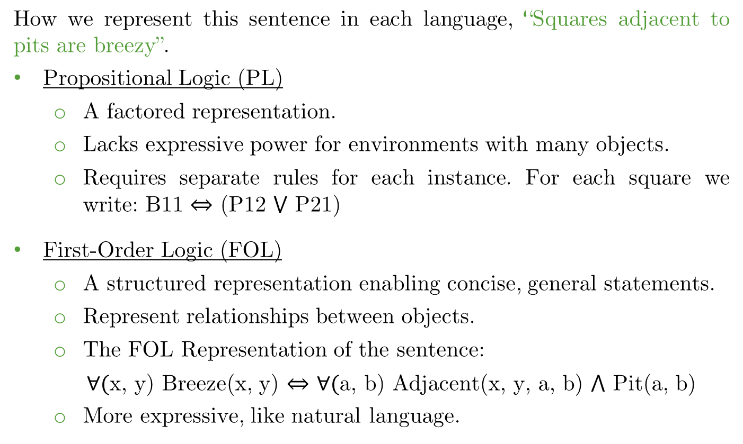
PL vs FOL
How we represent this sentence in each language, “Squares adjacent to pits are breezy”.
Propositional Logic (PL)
A factored representation.
Lacks expressive power for environments with many objects.
Requires separate rules for each instance. For each square we write: B11 ⇔ (P12 ⋁ P21)
First-Order Logic (FOL)
A structured representation enabling concise, general statements.
Represent relationships between objects.
The FOL Representation of the sentence:
$∀($x, y) Breeze(x, y) ⇔ ∀$($a, b) Adjacent(x, y, a, b) ⋀ Pit(a, b)
More expressive, like natural language.

Slide 4
First-Order Logic
Propositional Logic: Assumes the world consists of facts.
First-Order Logic (FOL): Assumes the world consists of:
Objects (e.g., students, cars)
Relations (e.g., brother-of, owns)
Properties (e.g., blue, large)
Functions (e.g., father-of, one-more-than)
Can express the following:
Squares neighboring the Wumpus are smelly.
Squares neighboring a pit are breezy.

Slide 5
Syntax of FOL
User defines these primitives:
Constant symbols, which represent individuals in the world, e.g., Mary, 3, green.
Function symbols, which map individuals to individuals, e.g., father-of(Mary) = John, color-of(Sky) = Blue.
Predicate symbols, which map individuals to truth values, e.g., greater(5,3), green(apple), color(apple, Green)

Slide 6
FOL Provides
Variable symbols:
Used to represent objects or properties of objects without explicitly naming the object.
E.g., x, y, foo.
Connectives:
Same as in PL: not (¬), and (⋀), or (⋁), implies (⇒), if and only if (biconditional ⇔).
Quantifiers:
Allow us to express properties of collections of objects instead of enumerating objects by name.
Universal: “for all” ∀<variable> <sentence>
Existential: “exists” ∃<variable> <sentence>

Slide 7
Predicates
A predicate symbol represents a relation in each universe of discourse.
A sentence in the form Relation(Term1, Term2, ...) is either true or false, depending on whether the relation holds for the given terms.
Example: To represent “Alex read books”.
Read(Alex, Books)
This sentence is true under the intended interpretation.

Slide 8
Functions
Function symbols represent mappings from objects to other objects within the universe of discourse.
Unlike predicate symbols, which express relationships that can be true or false, function symbols return a single unique object as output.
Map inputs to a single output (deterministic). Do not return true/false like predicates.
Example function symbols: father-of, best-friend, successor, sum.
father-of(John) = Mike → “Mike is John's father”.
sum(2, 3) = 5 → “The sum of 2 and 3 is 5”.

Slide 9
Properties of Quantifiers
∀x ∀y is the same as ∀y ∀x
∃x ∃y is the same as ∃y ∃x
∃x ∀y is not the same as ∀y ∃x:
∃x ∀y Loves(x,y)
“There is a person (x) who loves everyone (y) in the world”
∀y ∃x Loves(x,y)
“Everyone (y) in the world is loved by at least one person (x)”
Quantifier duality: each can be expressed using the other
∀x Likes(x, IceCream) ≡ ¬∃x ¬Likes(x, IceCream)
∃x Likes(x, Broccoli) ≡ ¬∀x ¬Likes(x, Broccoli)

Slide 10
Connection between Quantifiers
We can relate sentences involving ∀ and ∃ using De Morgan’s laws:
(∀x) ¬P(x) ⇔ ¬(∃x) P(x)
¬(∀x) P(x) ⇔ (∃x) ¬P(x)
(∀x) P(x) ⇔ ¬(∃x) ¬P(x)
(∃x) P(x) ⇔ ¬(∀x) ¬P(x)

Slide 11
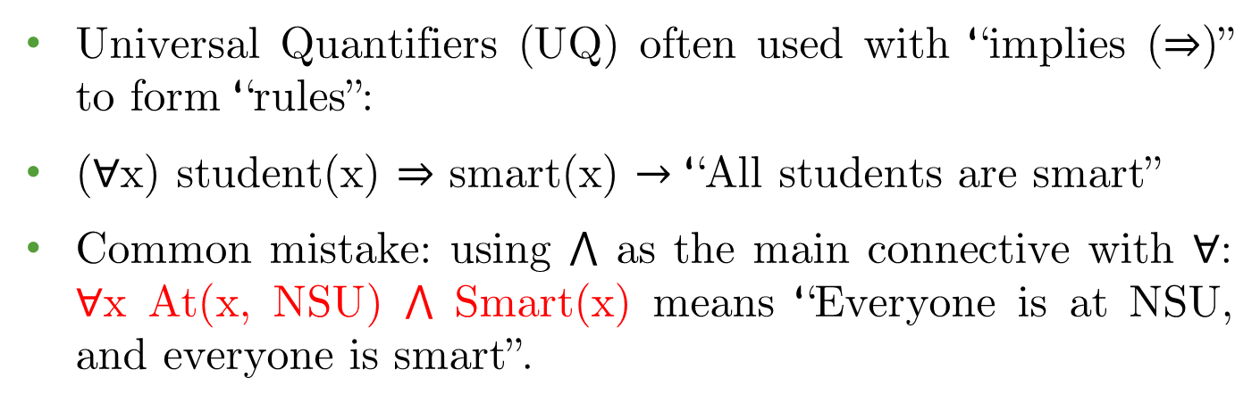
Quantifiers: use of ∀
Universal Quantifiers (UQ) often used with “implies (⇒)” to form “rules”:
(∀x) student(x) ⇒ smart(x) $→$ “All students are smart”
Common mistake: using ⋀ as the main connective with ∀: ∀x At(x, NSU) ⋀ Smart(x) means “Everyone is at NSU, and everyone is smart”.

Slide 12
Quantifiers: use of ∃
Existential Quantifiers (EQ) are usually used with “and” to specify a list of properties about an individual:
(∃x) student(x) ⋀ smart(x)
“There is a student who is smart”
A common mistake is to represent this English sentence as the FOL sentence:
(∃x) student(x) ⇒ smart(x)
But what happens when there is a person who is not a student?

Slide 13
Atomic Sentences
Atomic sentences in logic state facts that are true or false.
Atomic sentence = predicate(term_1, ..., term_n)
or term1 = term2
Term = function(term1, ..., term_n)
or constant or variable
Example terms:
Brother(Ali , Mohamed)
Greater(Length(x), Length(y))

Slide 14
Complex Sentences
Complex sentences are made from atomic sentences using connectives and by applying quantifiers.
Examples:
Sibling(Ali, Mohamed) ⇒ Sibling(Mohamed, Ali)
greater(1, 2) ∨ less-or-equal(1, 2)
∀ x, y Sibling(x, y) ⇒ Sibling(y, x)

Slide 15
English to FOL
Mary is not tall.
¬tall(Mary)
Every gardener likes the sun.
∀x gardener(x) ⇒ likes(x, Sun)
You can fool some of the people all the time.
∃x ∀t person(x) ⋀ time(t) ⇒ can-fool(x, t)
You can fool all the people some of the time.
∀x ∃t (person(x) ⇒ time(t) ⋀ can-fool(x, t))
∃x (person(x) ⇒ ∃t (time(t) ⋀ can-fool(x, t))

Slide 16
English to FOL
No purple mushroom is poisonous.
¬(∃x) purple(x) ⋀ mushroom(x) ⋀ poisonous(x)
(∀x) (mushroom(x) ⋀ purple(x)) ⇒ ¬poisonous(x)
There are exactly two purple mushrooms.
(∃x)(∃y) mushroom(x) ⋀ purple(x) ⋀ mushroom(y) ⋀ purple(y) ⋀ ¬(x=y) ⋀ (∀z) (mushroom(z) ⋀ purple(z)) ⇒ ((x=z) ⋁ (y=z))
X is above Y if X is on directly on top of Y or else there is a pile of one or more other objects directly on top of one another starting with X and ending with Y.
(∀x)(∀y) above(x,y) ⇔ (on(x,y) ⋁ (∃z) (on(x,z) ⋀ above(z,y)))

Slide 17
FOL to English
∀x has-a(x, Bachelors) ⇒ is-a(x, human)
Everyone who has a bachelors is human.
∃x has-a(x, Bachelors)
There exists some who has a bachelors.
∀x ∃y Loves(x, y)
Everybody loves somebody
∀x Man(x) ⇒ Mortal(x)
All men are mortal

Slide 18
FOL Exercise
1. Everything is bitter or sweet. 2. Either everything is bitter, or everything is sweet. 3. There is somebody who is loved by everyone. 4. Nobody is loved by no one. 5. If someone is noisy, everybody is annoyed. 6. Frogs are green. 7. Frogs are not green. | 8. No frog is green. 9. Some frogs are not green. 10. A mechanic likes Bob. 11. A mechanic likes herself. 12. Every mechanic likes Bob. 13. Some mechanic likes every nurse. 14. There is a mechanic who is liked by every nurse.

Slide 19
FOL Exercise
1. ∀x (bitter(x) ⋁ sweet(x)) 2. ∀x (bitter(x)) ⋁ ∀x (sweet(x)) 3. ∃x ∀y (loves(y, x)) 4. ¬∃x ¬∃y (loves(y, x)) 5. ∃x (noisy(x)) ⇒ ∀y(annoyed(y)) 6. ∀x (frog(x) ⇒ green(x)) 7. ∀x (frog(x) ⇒ ¬green(x)) | 8. ¬∃x (frog(x) ⋁ green(x)) 9. ∃x (frog(x) ⋁ ¬green(x)) 10. ∃x (mech.(x) ⋁ likes(x, Bob)) 11. ∃x (mech.(x) ⋁ likes(x, x)) 12. ∀x (mech.(x) ⇒ likes(x, Bob)) 13. ∃x ∀y (mech(x) ⋁ nurse(y) ⇒ likes(x, y)) 14. ∃x(mech(x) ∧ ∀y(nurse(y) ⇒ likes(y, x))

Slide 20
Inference in FOL
Inference in FOL can be performed by:
Reduce FOL to PL (Propositionalization)
Unification
Generalized Modus Ponens
Forward chaining
Backward chaining
Resolution

Slide 21
From FOL to PL
First-order inference can be done by converting the Knowledge Base to PL and using propositional inference.
How to convert universal quantifiers ∀ ?
Replace variable by ground term (a term without variables).
How to convert existential quantifiers ∃ ?
Skolemization.

Slide 22
Universal Instantiation (UI)
If (∀x) P(x) is true, then P(c) is true, where c is a constant in the domain of x.
For example, from (∀x) eats(Ziggy, x) we can infer eats(Ziggy, IceCream).
The variable symbol can be replaced by any ground term, i.e., any constant symbol or function symbol applied to ground terms only.
In general, Subst({v/g}, α) means the result of substituting g for v in sentence α.

Slide 23
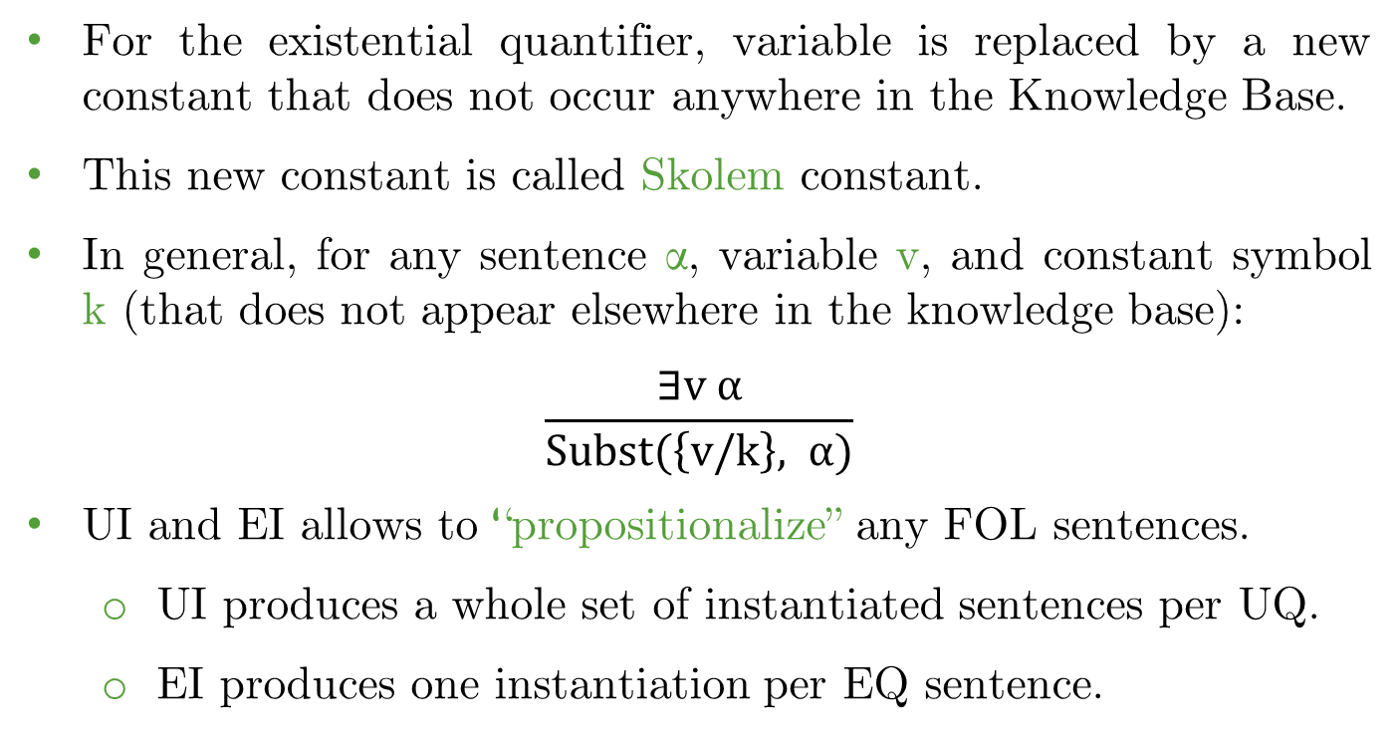
Existential Instantiation (EI)
For the existential quantifier, variable is replaced by a new constant that does not occur anywhere in the Knowledge Base.
This new constant is called Skolem constant.
In general, for any sentence α, variable v, and constant symbol k (that does not appear elsewhere in the knowledge base):
$$\frac{∃v α}{Subst(\left\{v/k\right\}, α)}$$
UI and EI allows to “propositionalize” any FOL sentences.
UI produces a whole set of instantiated sentences per UQ.
EI produces one instantiation per EQ sentence.

Slide 24
FOL to PL Exercise
Suppose the KB contains the following:
Jim is a turtle: Turtle(Jim) Deb is a rabbit: Rabbit(Deb) Turtles outlast Rabbits: ∀x,y (Turtle(x) ⋀ Rabbit(y)) ⇒ Outlast(x,y)
Query: Jim outlasts Deb – Outlast(Jim, Deb)

Slide 25
FOL to PL Exercise
Suppose the KB contains the following: | Instantiating the universal sentence in all possible ways, we have:
Jim is a turtle: Turtle(Jim) Deb is a rabbit: Rabbit(Deb) Turtles outlast Rabbits: ∀x,y (Turtle(x) ⋀ Rabbit(y)) ⇒ Outlast(x,y) | 4. Turtle(Jim) ⋀ Rabbit(Deb) (And Introduction 1, 2) 5. Turtle(Jim) ⋀ Rabbit(Deb) ⇒ Outlast(Jim, Deb) (Universal Instantiation 3) 6. Outlast(Jim, Deb) (Modus Ponens 4, 5) QED
Query: Jim outlasts Deb – Outlast(Jim, Deb)

Slide 26
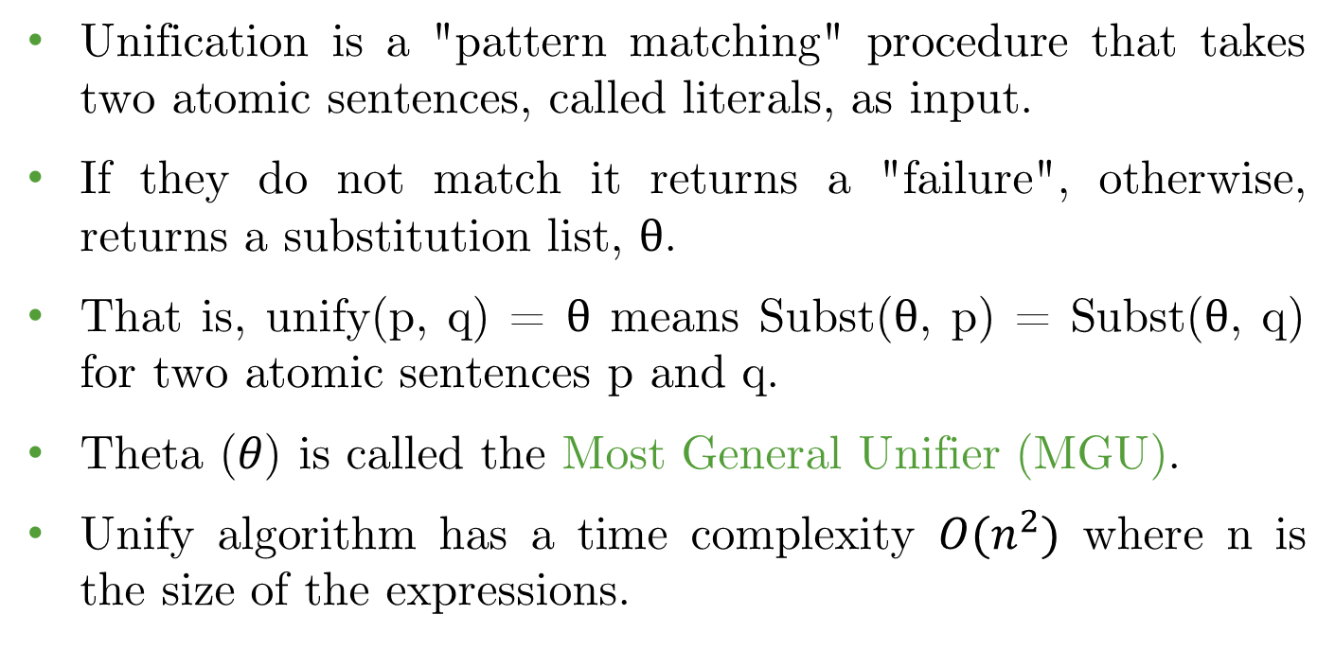
Unification
Unification is a "pattern matching" procedure that takes two atomic sentences, called literals, as input.
If they do not match it returns a "failure", otherwise, returns a substitution list, $θ$.
That is, unify(p, q) = $θ$ means Subst($θ$, p) = Subst($θ$, q) for two atomic sentences p and q.
Theta (𝜃) is called the Most General Unifier (MGU).
Unify algorithm has a time complexity $O(n^{2})$ where n is the size of the expressions.

Slide 27
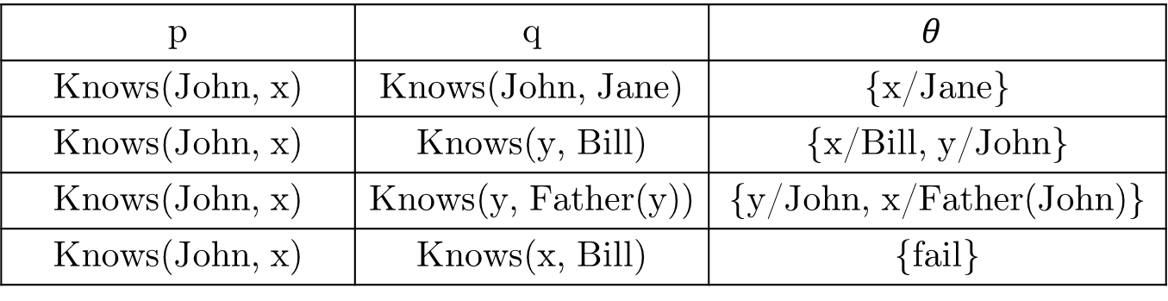
Unification
p | q | $$θ$$
Knows(John, x) | Knows(John, Jane) | {x/Jane}
Knows(John, x) | Knows(y, Bill) | {x/Bill, y/John}
Knows(John, x) | Knows(y, Father(y)) | {y/John, x/Father(John)}
Knows(John, x) | Knows(x, Bill) | {fail}
Last unification fails only because x can’t take values John and Bill at the same time.
Problem is due to use of same variable x in both sentences.
Variables must be standardized apart!
If the same variable is found in both p and q, then rename variable, so none are shared.

Slide 28
Unification Example
“Unify” rule premises with known facts and apply unifier to conclusion.
Rule:
∀x,y (Turtle(x) ⋀ Rabbit(y)) ⇒ Outlast(x,y)
Known facts:
Turtle(Jim)
Rabbit(Deb)
Unifier: {x/Jim, y/Deb}
Apply unifier to conclusion: Outlast(Jim, Deb)

Slide 29
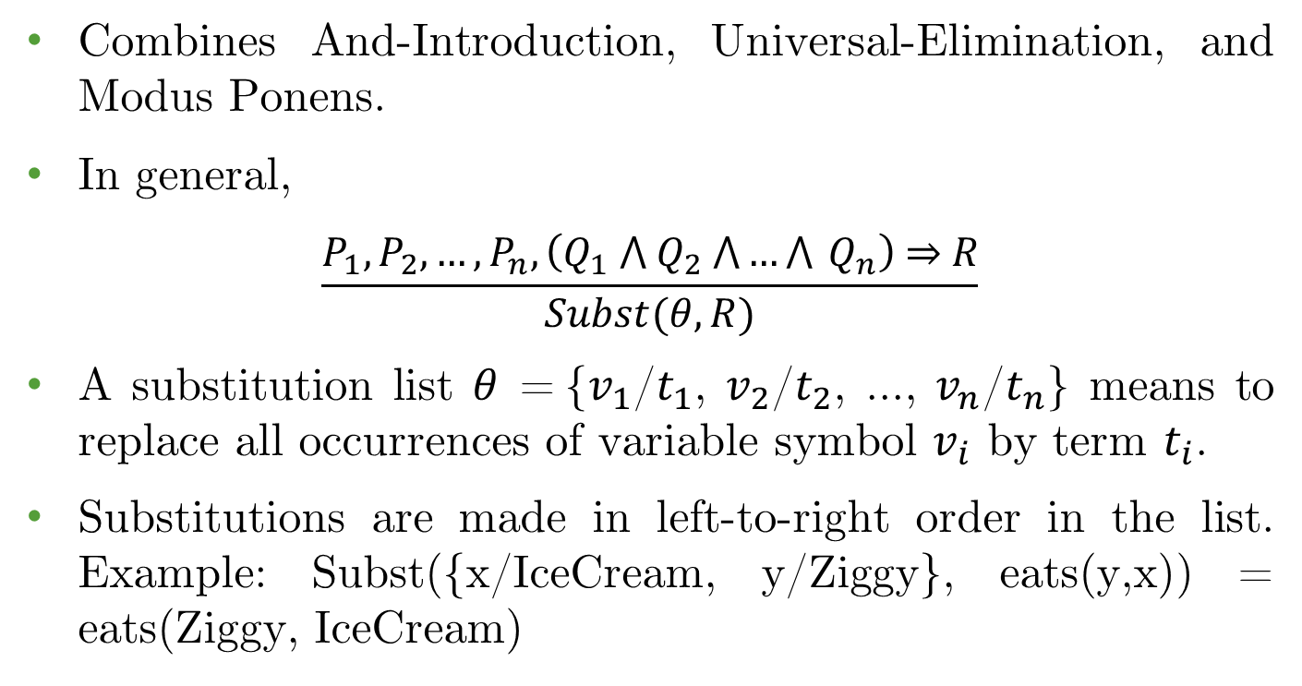
Generalized Modus Ponens
Combines And-Introduction, Universal-Elimination, and Modus Ponens.
In general,
$$\frac{P_{1}, P_{2}, …, P_{n}, \left(Q_{1} \text{⋀} Q_{2} \text{⋀}…\text{⋀} Q_{n}\right) \text{⇒} R}{Subst(θ, R)}$$
A substitution list $θ$ = {$v_{1}$/$t_{1}$, $v_{2}$/$t_{2}$, ..., $v_{n}$/$t_{n}$} means to replace all occurrences of variable symbol $v_{i}$ by term $t_{i}$.
Substitutions are made in left-to-right order in the list. Example: Subst({x/IceCream, y/Ziggy}, eats(y,x)) = eats(Ziggy, IceCream)

Slide 30
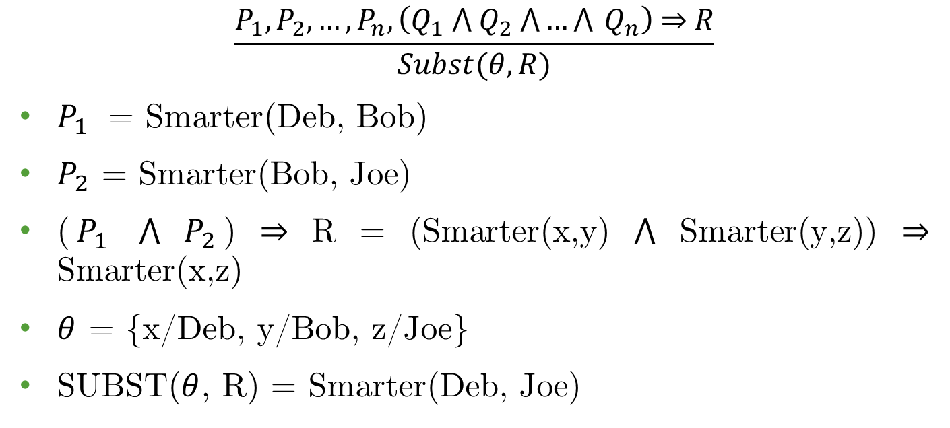
Generalized Modus Ponens Example
$$\frac{P_{1}, P_{2}, …, P_{n}, \left(Q_{1} \text{⋀} Q_{2} \text{⋀}…\text{⋀} Q_{n}\right) \text{⇒} R}{Subst(θ, R)}$$
$P_{1}$ = Smarter(Deb, Bob)
$P_{2}$ = Smarter(Bob, Joe)
($P_{1}$ ⋀ $P_{2}$) ⇒ R = (Smarter(x,y) ⋀ Smarter(y,z)) ⇒ Smarter(x,z)
$θ$ = {x/Deb, y/Bob, z/Joe}
SUBST($θ$, R) = Smarter(Deb, Joe)

Slide 31
Completeness of FOL Inference
Truth table enumeration: incomplete for FOL.
Table may be infinite in size for infinite domain.
Natural Deduction: complete for FOL.
But impractical since branching factor too large.
GMP: incomplete for FOL (In general).
Not every sentence can be converted to Horn form.
GMP: complete for FOL if KB contains only Horn clauses.
Forward Chaining: move from KB to query.
Backward chaining: move from query to KB.

Slide 32
Forward Chaining
Forward chaining inference procedure moves "forward" from the KB to the goal.
Example: KB = All cats like fish, cats eat everything they like, and Ziggy is a cat.
KB:
(∀x) cat(x) ⇒ likes(x, Fish)
(∀x)(∀y) (cat(x) ⋀ likes(x,y)) ⇒ eats(x,y)
cat(Ziggy)
Goal query: Does Ziggy eat fish?

Slide 33
Forward Chaining
Proof:
(∀x) cat(x) ⇒ likes(x, Fish)
(∀x)(∀y) (cat(x) ⋀ likes(x,y)) ⇒ eats(x,y)
cat(Ziggy)
likes(Ziggy, Fish) GMP with (1) and (3)
eats(Ziggy, Fish) GMP with (3), (4), and (2)
QED
So, Yes, Ziggy eats fish.

Slide 34
Backward Chaining
Proofs start with the goal query, find implications (sub-goal) that would allow you to prove it.
Then prove each of the antecedents in the implication, continuing to work "backwards" until we get to the axioms, which we know are true.
Example: Does Ziggy eat fish?
To prove eats(Ziggy, Fish), first see if this is known from one of the axioms directly.
Here it is not known, so see if there is a Horn clause that has the consequent (i.e., right-hand side) of the implication matching the goal.

Slide 35
Backward Chaining
Proof:
(∀x) cat(x) ⇒ likes(x, Fish)
(∀x)(∀y) (cat(x) ⋀ likes(x,y)) ⇒ eats(x,y)
cat(Ziggy)
eats(Ziggy, Fish) (Goal)
cat(Ziggy) ⋀ likes(Ziggy, Fish) (Subgoal (2))
cat(Ziggy) (Subgoal (5), True (3), proven)
likes(Ziggy, Fish) (Subgoal (5))
likes(Ziggy, Fish) (Using (6), subgoal is proven)
cat(Ziggy) ⋀ likes(Ziggy, Fish) (using (6) and (8), subgoal is proven)
eats(Ziggy, Fish) QED

Slide 36
Resolution
Resolution procedure is a sound and complete inference procedure for FOL.
Resolution procedure uses a single rule of inference: the Resolution Rule (RR), which is a generalization of the same rule used in PL.
Given A ⋁ B and ¬B ⋁ C are true, we can conclude that A ⋁ C is true.
The KB needs to be in conjunctive normal form (CNF) format and any KB can be converted to CNF.
To infer KB ╞ 𝛼, we show KB ⋀ ¬𝛼 is unsatisfiable.

Slide 37
CNF Example
Convert the sentence to CNF:
(∀x) (P(x) ⇒ ((∀y) (P(y) ⇒ P(f(x,y))) ⋀ ¬(∀y)(Q(x,y) ⇒ P(y))))
1. Eliminate ⇒
(∀x)(¬P(x) ⋁ ((∀y)(¬P(y) ⋁ P(f(x,y))) ⋀ ¬(∀y)(¬Q(x,y) ⋁ P(y))))
2. Reduce scope of negation
(∀x)(¬P(x) ⋁ ((∀y)(¬P(y) ⋁ P(f(x,y))) ⋀ (∃y)(Q(x,y) ⋀ ¬P(y))))
3. Standardize variables
(∀x)(¬P(x) ⋁ ((∀y)(¬P(y) ⋁ P(f(x,y))) ⋀ (∃z)(Q(x,z) ⋀ ¬P(z))))
4. Eliminate existential quantification
(∀x)(¬P(x) ⋁ ((∀y)(¬P(y) ⋁ P(f(x,y))) ⋀ (Q(x, g(x)) ⋀ ¬P(g(x)))))
5. Drop universal quantification symbols
(¬P(x) ⋁ ((¬P(y) ⋁ P(f(x,y))) ⋀ (Q(x, g(x)) ⋀ ¬P(g(x)))))

Slide 38
CNF Example
5. Drop universal quantification symbols
(¬P(x) ⋁ ((¬P(y) ⋁ P(f(x,y))) ⋀ (Q(x, g(x)) ⋀ ¬P(g(x)))))
6. Convert to conjunction of disjunctions
(¬P(x) ⋁ ¬P(y) ⋁ P(f(x,y))) ⋀ (¬P(x) ⋁ Q(x, g(x))) ⋀ (¬P(x) ⋀ ¬P(g(x)))
7. Create separate clauses
¬P(x) ⋁ ¬P(y) ⋁ P(f(x,y))
¬P(x) ⋁ Q(x, g(x))
¬P(x) ⋁ ¬P(g(x))
8. Standardize variables
¬P(x) ⋁ ¬P(y) ⋁ P(f(x,y))
¬P(z) ⋁ Q(z, g(z))
¬P(w) ⋁ ¬P(g(w))

Slide 39
CNF Exercise
First, translate the sentence to FOL.
Anyone who likes all animals is loved by someone:
∀x (∀y Animal(y) ⇒ Likes(x, y)) ⇒ (∃y Loves(y, x))
Final Answer:
(Animal(F(x)) ⋁ Loves(G(x), x)) ⋀ (¬Loves(x, F(x)) ⋁ Loves(G(x), x))

Slide 40
Hoofers Club
Problem Statement: Tony, Shi-Kuo and Ellen belong to the Hoofers Club. Every member of the Hoofers Club is either a skier or a mountain climber or both. No mountain climber likes rain, and all skiers like snow. Ellen dislikes whatever Tony likes and likes whatever Tony dislikes. Tony likes rain and snow.
Query: Is there a member of the Hoofers Club who is a mountain climber but not a skier?
Let S(x) mean x is a skier, M(x) mean x is a mountain climber, and L(x,y) mean x likes y, where the domain of the first variable (x) is Hoofers Club members, and the domain of the second variable (y) is snow and rain.

Slide 41
Hoofers Club
We can now translate the above English sentences into the following FOL:
1. (∀x) S(x) ⋁ M(x) (Every member is either a skier or a mountain climber or both.)
2. ¬(∃x) M(x) ⋀ L(x, Rain) (No mountain climber likes rain.)
3. (∀x) S(x) ⇒ L(x, Snow) (All skiers like snow.)
4. (∀y) L(Ellen, y) ⇔ ¬L(Tony, y) (Ellen dislikes whatever Tony likes and likes whatever Tony dislikes)
5. L(Tony, Rain) (Tony likes rain.)
6. L(Tony, Snow) (Tony likes snow.)
Query: (∃x) M(x) ⋀ ¬S(x) (Is there a member of the Club who is a mountain climber but not a skier?)
Negation of the Query: ¬(∃x) M(x) ⋀ ¬S(x)

Slide 42
Hoofers Club
Conversion to CNF Form
KB: | Clause Form:
1. (∀x) S(x) ⋁ M(x) | 1. S(x1) ⋁ M(x1)
2. ¬(∃x) M(x) ⋀ L(x, Rain) | 2. ¬M(x2) ⋁ ¬L(x2, Rain)
3. (∀x) S(x) ⇒ L(x, Snow) | 3. ¬S(x3) ⋁ L(x3, Snow)
4. (∀y) L(Ellen, y) ⇔ ¬L(Tony, y) | 4. ¬L(Tony, x4) ⋁ ¬L(Ellen, x4) 5. L(Tony, x5) ⋁ L(Ellen, x5)
5. L(Tony, Rain) | 6. L(Tony, Rain)
6. L(Tony, Snow) | 7. L(Tony, Snow)
Query: (∃x) M(x) ⋀ ¬S(x)
Negation of the Query: ¬(∃x) M(x) ⋀ ¬S(x) | Negation of the Query: ¬M(x7) ⋁ S(x7)

Slide 43
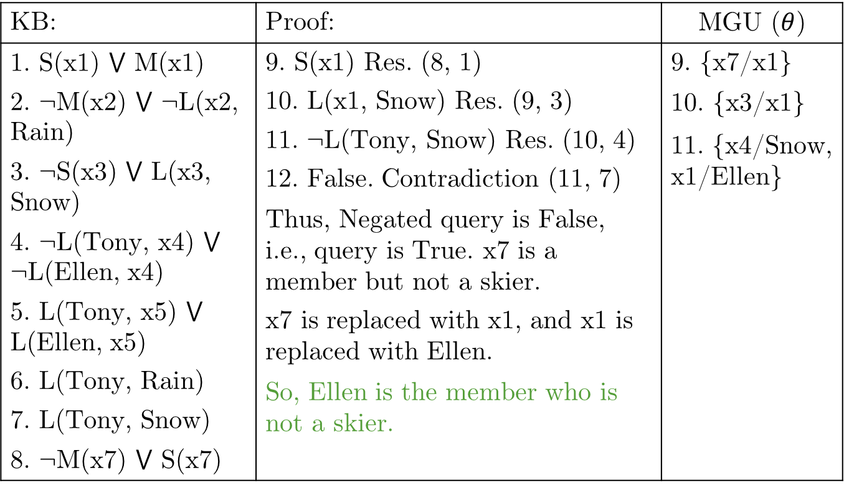
Hoofers Club
KB: | Proof: | MGU ($θ$)
1. S(x1) ⋁ M(x1) 2. ¬M(x2) ⋁ ¬L(x2, Rain) 3. ¬S(x3) ⋁ L(x3, Snow) 4. ¬L(Tony, x4) ⋁ ¬L(Ellen, x4) 5. L(Tony, x5) ⋁ L(Ellen, x5) 6. L(Tony, Rain) 7. L(Tony, Snow) 8. ¬M(x7) ⋁ S(x7) | 9. S(x1) Res. (8, 1) 10. L(x1, Snow) Res. (9, 3) 11. ¬L(Tony, Snow) Res. (10, 4) 12. False. Contradiction (11, 7) | 9. {x7/x1}
 |  | 10. {x3/x1}
 |  | 11. {x4/Snow, x1/Ellen}
 | Thus, Negated query is False, i.e., query is True. x7 is a member but not a skier. x7 is replaced with x1, and x1 is replaced with Ellen.
 | So, Ellen is the member who is not a skier.

Slide 44
Reading
Chapter 08: First Order Logic
Chapter 09: Inference in First Order Logic

